Slide 1
How AI can enhance Health System and save our Humanity
Ling Tong
Notes:
Time limit: 10 mins
Reference:
Kaifu Lee: How AI can save our humanity, https://www.ted.com/talks/kai_fu_lee_how_ai_can_save_our_humanity?subtitle=en
Artificial Intelligence In Healthcare Market, https://www.grandviewresearch.com/industry-analysis/artificial-intelligence-ai-healthcare-market

Slide 2
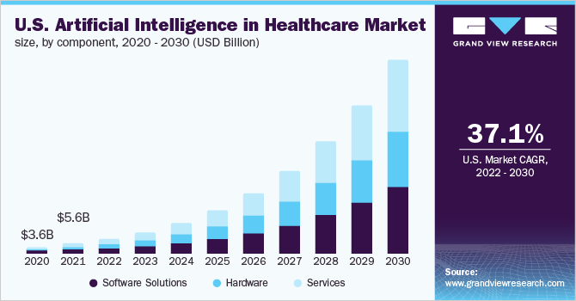
Notes:
I’m going to talk about how AI and mankind can co-exist in our world, and how it will change our healthcare system.
But before I start talk with this serious topic, I want to tell you a little bit of my research story.
In my undergraduate school, I was one of the top student in computer science, and in programming.
Because of that reason, I attended into a professor’s lab, and she is specialized in health informatics.
Because of her, I begin to know what is research, and begin to prepare my future study in the united states.
Finally, I was admitted in University of Wisconsin Milwaukee in a health informatics program,
It was only five years ago.
I was still dreaming what kind of researches I can do in my phd programs.
On September 13, at 9 pm, I remember it very clearly, she send me a message: hey, look at this paper! And She send me a link.

Slide 3
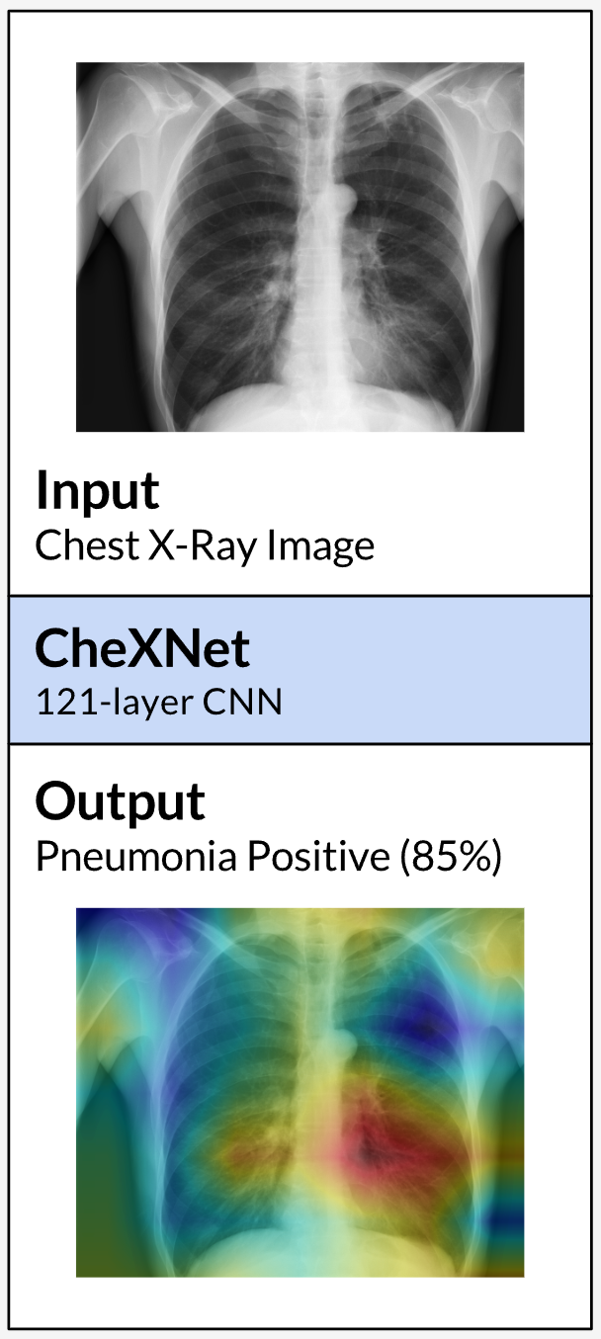
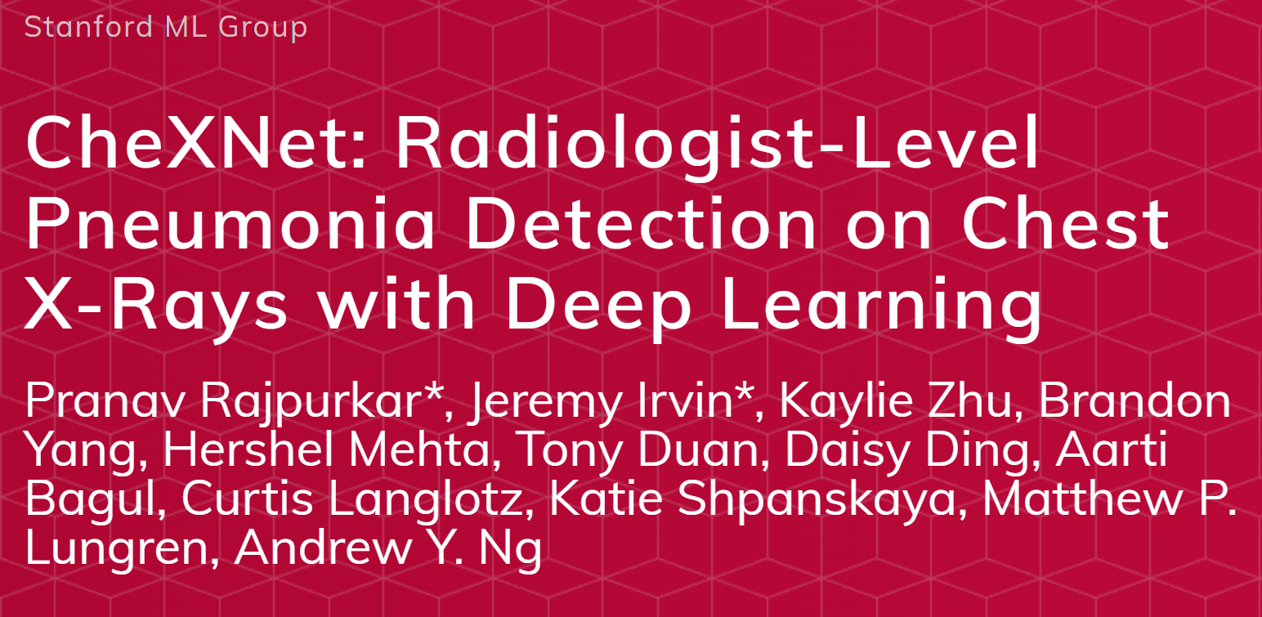
Notes:
It was the paper that claims “took over” the radiologist’s job.
To put everything very simple, this paper created a ‘AI radiologist’ and can recognized the pneumonia in a superhuman accuracy.
After many reproducible works, all scientists confirmed it is true.
And that is the moment I found myself in a crossroad.
Computer Science can achieve superhuman power.
I speak that to myself, I will create similar amazing product like this one, not today, but some day.
But at that time, I did not realize I was also a ‘product’ of my school and computer science.
I was fascinated in the technical details of these models, and completely ignored this thing’s impact to humans.

Slide 4
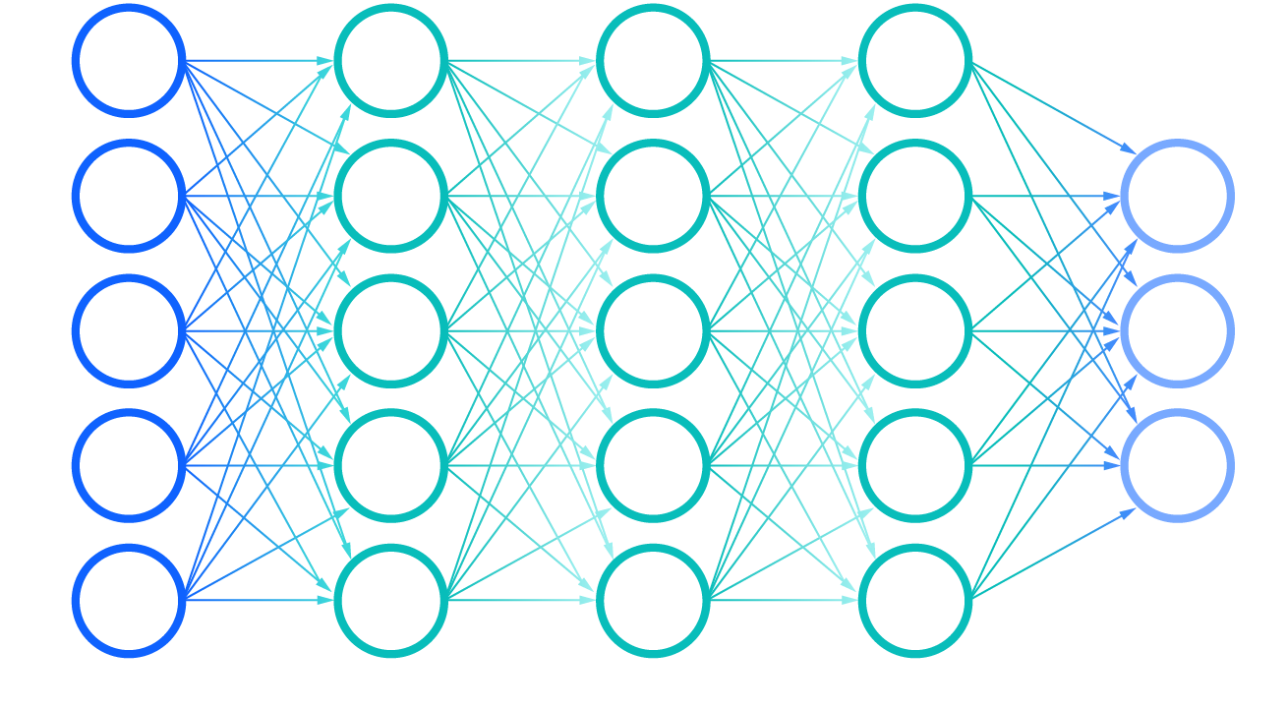
Deep Learning
Notes:
If you want to learn how AI can shift the world, especially in health care, you need to know at least some background of these things: Deep learning.
As the AI discovery continues, more scientist put more efforts on the AI topic.
About 10 years ago, three Americans find the grand discovery, which is called deep learning.
Since then, Deep learning becomes the computer’s brain and created endless opportunities.

Slide 5
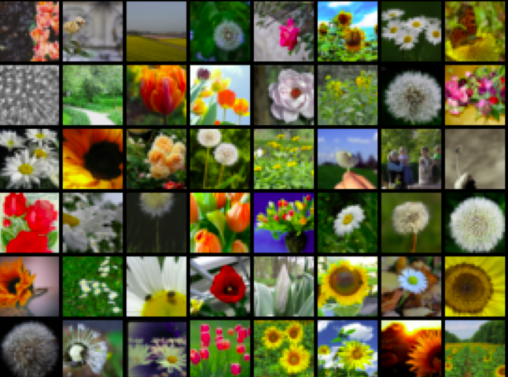

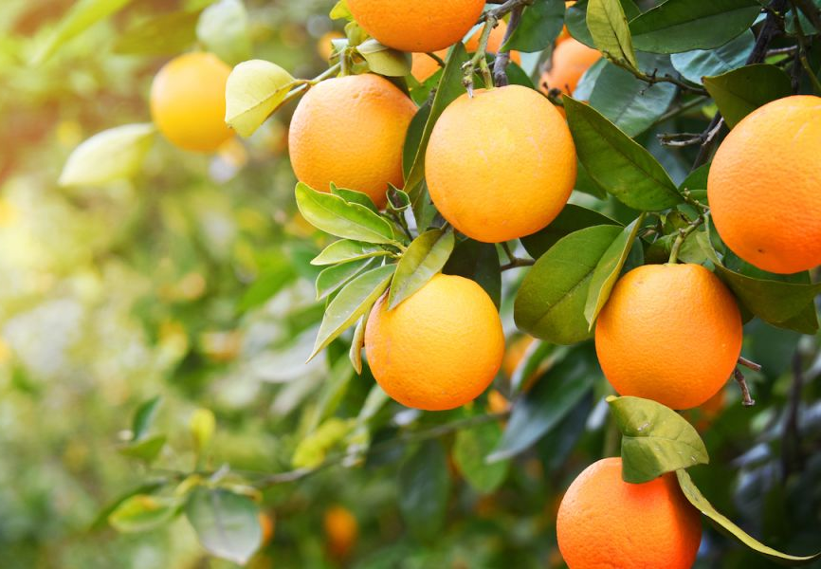
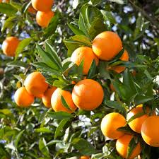
Flower
Flower image corpus
Not Flower
Notes:
Deep learning is a technology that can take huge amount of data in a single domain, and learn to decide at incredible accuracy.
For example, if we show deep learning framework a massive number of flower photos, it can recognize a plant as flower, or not flower.

Slide 6
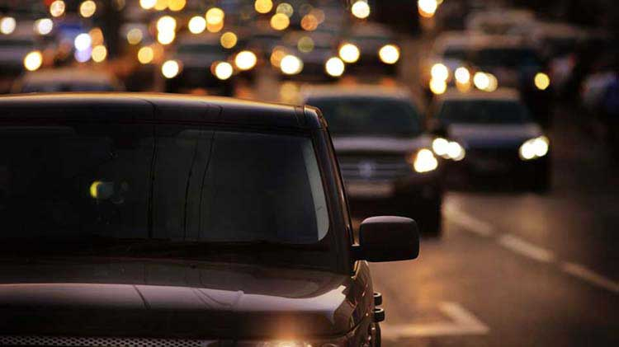
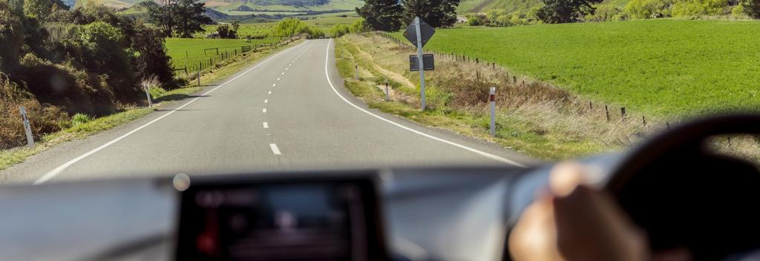
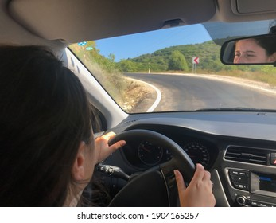
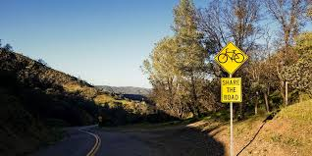
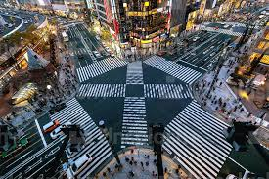
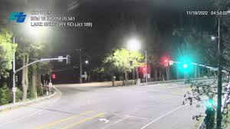
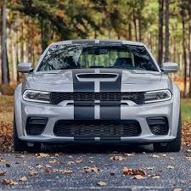
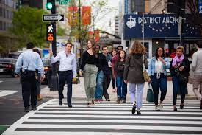
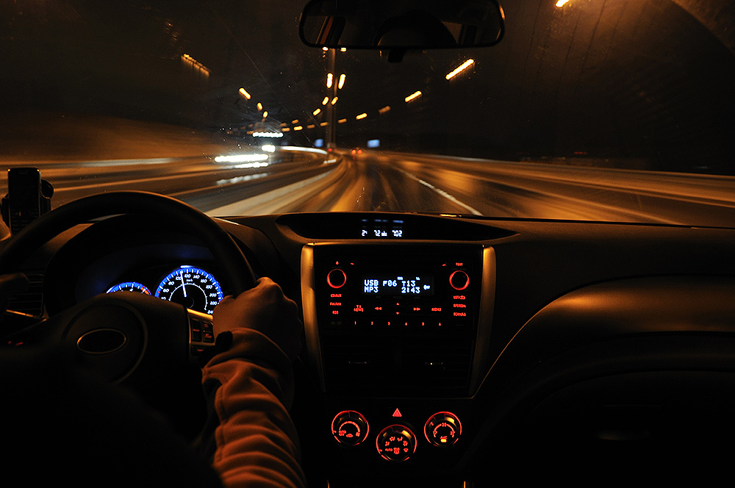
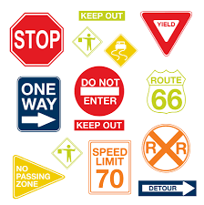

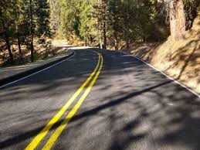
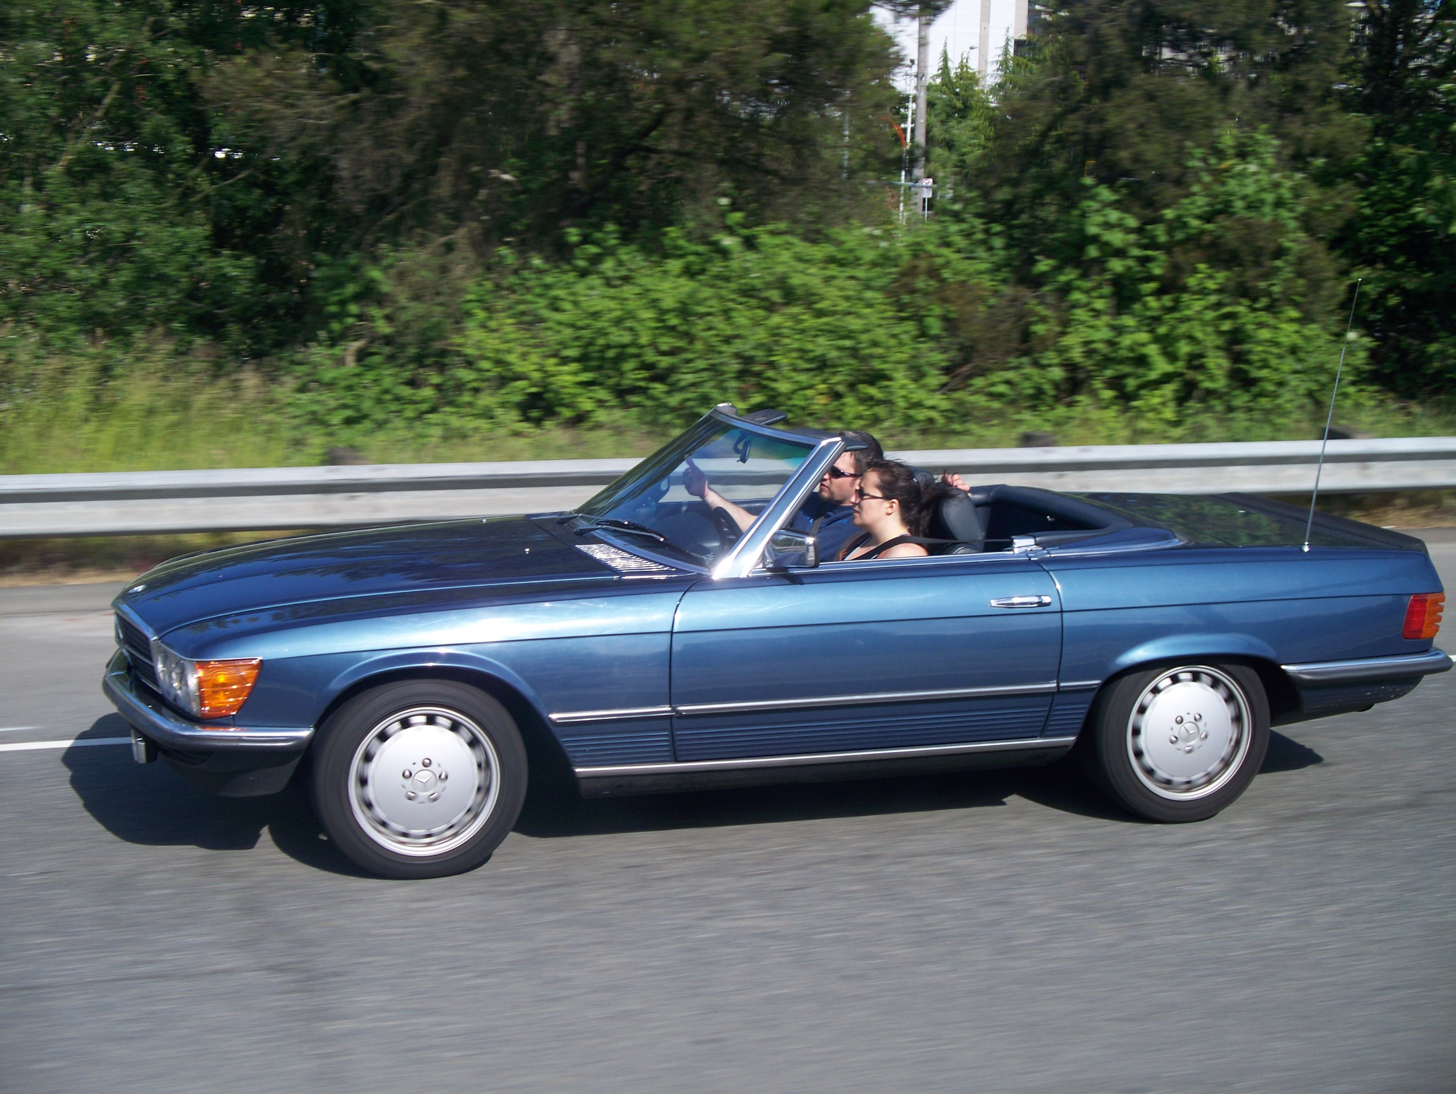
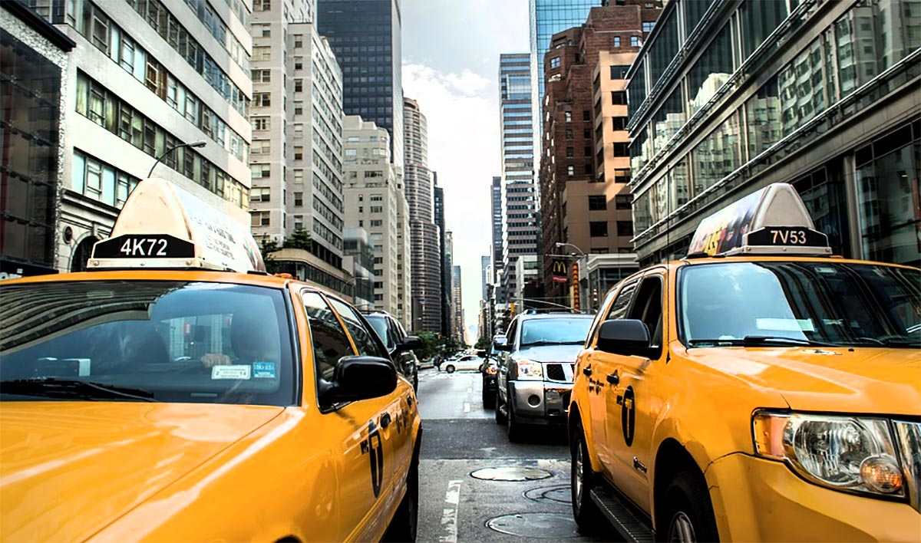
Auto Driving
Video/sensor images
Notes:
Or, we can show it many pictures and videos and sensor data from driving on the highway, it can actually drive a car as well as a human being on the highway.
Perhaps you will say, well, I don’t mind driving myself, I do not trust these things and put my life on this model.
But, something will emerge as a key component in healthcare facilities, such as this one:
Deep learning has progressed so fast, so it begins to work on some specialized field of medicine. Let me show you a few more examples:

Slide 7
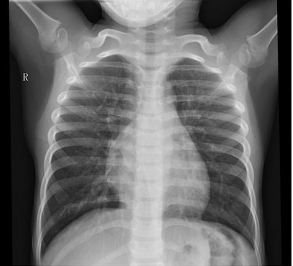
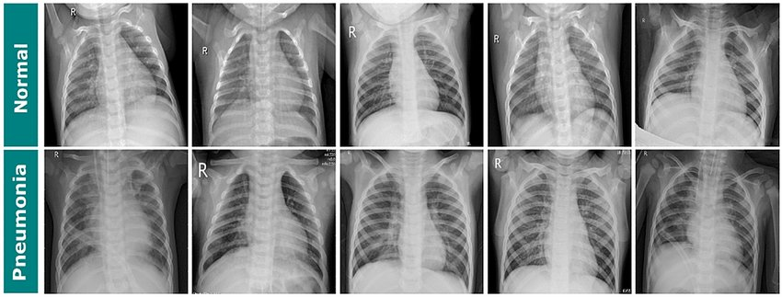
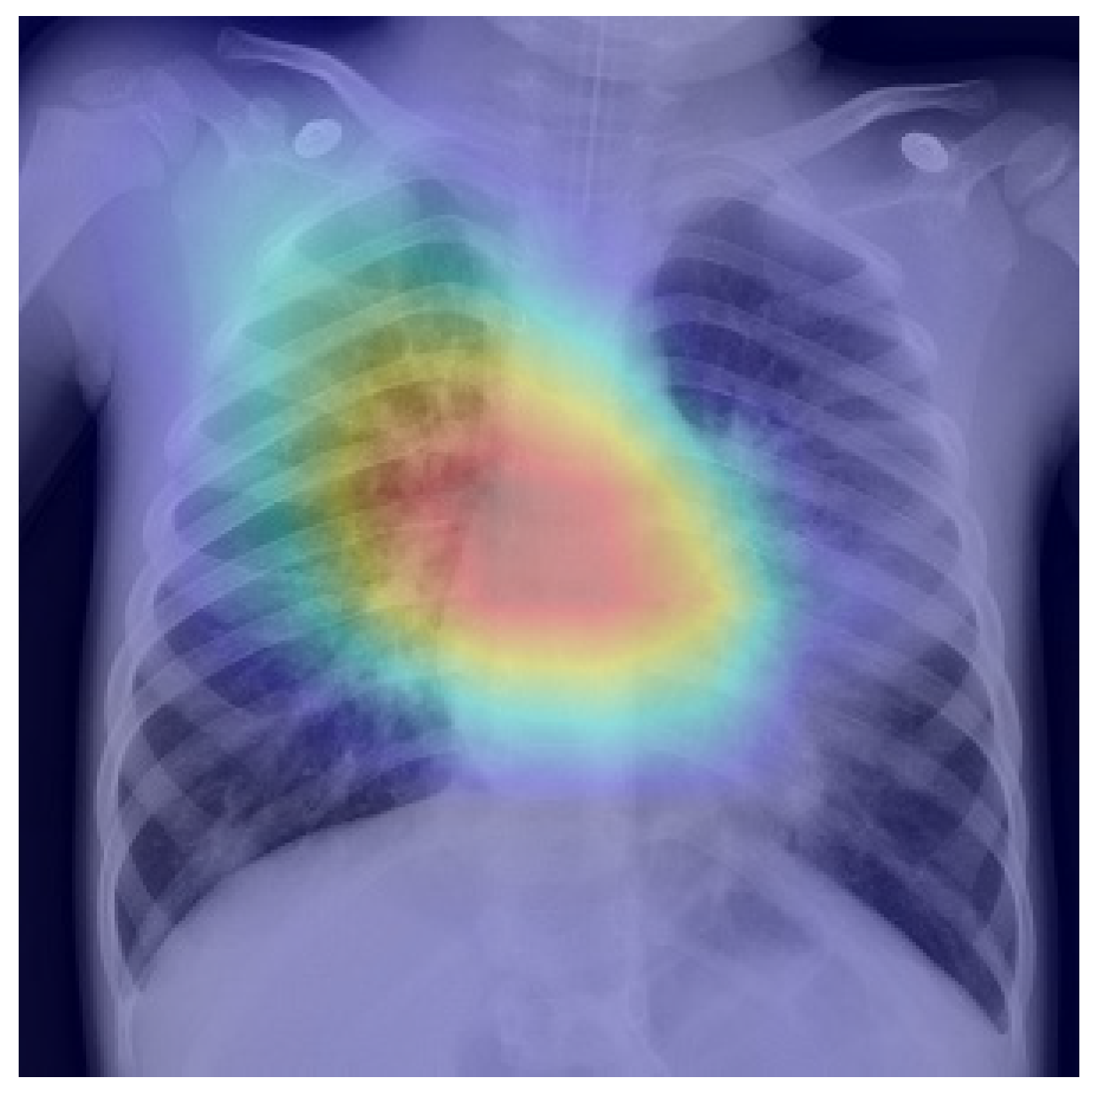
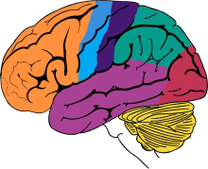
Normal
Computer’s brain
VS
Physician’s brain?
Pneumonia
Notes:
This is example for the previous paper. if we use a massive number of Chest x-ray images for computer to learn, the computer can take one to two days to learn 100 thousands X-ray images, and quickly identify the problems in an new X-ray. If a Physician want to learn that skills, that might took 20 years to reach the same expertise.

Slide 8
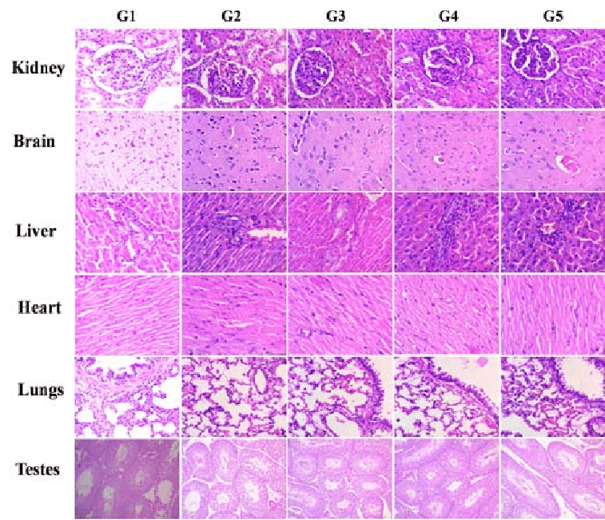
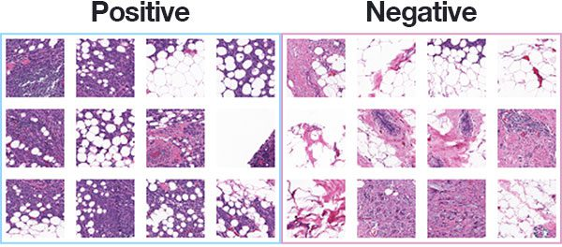
Benign tumor
Computer’s brain
VS
Anisuzzaman, D. M., Barzekar, H., Tong, L., Luo, J., & Yu, Z. (2021).
A deep learning study on osteosarcoma detection from histological
images. Biomedical Signal Processing and Control, 69, 102931.
Physician’s brain?
Malignant tumor
Notes:
In the same way, if we use a histological images and teach a deep learning model, what a malignant tumor cell looks like, and what a benign tumor cell looks like,
they will quickly learn to identify the most terrible disease in our planet, cancer.
By the way, my lab have published a paper on these things, and the paper is available as “A deep learning study on osteosarcoma detection from histological images”.
So, I’m sure I joined into this big AI ecosystem in health care, and earned a unique position in this transformation.

Slide 9
Deep Learning
Human Brain
Automation
Notes:
(The comparison of AI, Deep learning and human brain)

Slide 10
Optimization
Creativity/Strategy
Repetitive
Routine
Optimizing
Analyzing
Creative
Dishwasher
Vending Machine
Laundry
Robot Vacuum
Truck Driver
Front Desk
Radiologist
Sports Coach
Hematologist
Physician
Analyst
Business Consultant
Scientist
Musician
Artist
Notes:
The AI engine is running, and begin to take over most repetitive. Think about the last time you use a dishwasher, and vending machine. They becomes so prevalent. Even we do not notice they used to be part of human work.
AI has taken over the repetitive works in the first column. Dishwasher, vending machine, laundry, all of them saved our lost of work.
And it's not just for repetitive works, but routines, such as house cleaning, and even jobs like front desk, customer service and hematologists, radiologists, over the next 15 years, these jobs will be gone.
And only the creative jobs are like physicians, analysis, scientist, musician or artist, which requires creativity.
Really, the creative jobs are the ones that are protected, because AI can optimize but not create.
How can we make ourselves valuable in the world of AI? It’s not about we worry about what we’re going to lose,
But more like a what we can highlight ourselves as a human

Slide 11
High Compassion needed
CEO
Nurse
Social Worker
Physician
Instructor
Dietition
Caregiver
Physical
Therapist
Journalist
Tour Guide
Family Medicine
Artist
Sports Coach
Front Desk
Customer Support
Consultant
AI chat bot
Optimization
Creativity/Strategy
Tele-sales
Pneumonia Detection
Radiologist
Research Analyst
Scientist
Medical Technician
Musician
Hematologist
Cancer Detection
Robot Vacuum
Attorney
Auto driving
Programmer
Dishwasher
Truck Driver
Vending Machine
Medical Billing
Laundry
Compassion not needed
Notes:
To better measure our capability as a human, we can bring the second axis called ‘love’, ‘empathy’, or ‘compassion’, that is what AI cannot do.
And we can bring more jobs into this graph, according to how much creativity, and how much compassion we need in a job.
Since AI have taken away our routine jobs, I would like to think the next few challenges we’re addressing,
They still do not require compassion and too much creativity. Many jobs requires us being human and put love into our jobs.
Currently, It is impossible for AI to provide such compassions to the world.
Such a chart will guide us to find the right position in our life career choices.
This graph is surely not perfect, but it points at four ways that we can work with AI.
- AI will come and take away the routine jobs and in due time, we will be thankful.
- AI will become great tools for the creatives so that scientists, artists, musicians and writers can be even more creative.
- AI will work with humans as analytical tools that humans can wrap their warmth around for the high-compassion jobs.
And we can always differentiate ourselves with the uniquely capable jobs that are both compassionate and creative,
using and leveraging our irreplaceable brains and hearts. So there you have it: a blueprint of coexistence for humans and AI.

Slide 12
Key Takeaways
AI is transforming healthcare world and taking millions of jobs in the next 10 years.
There is one thing AI cannot do: Love.
My research study’s roadmap in an “AI and Healthcare” world, why important?
It is AI to liberate us from routine jobs, and It is health and care to remind what makes us as a human.
Notes:
It is here to liberate us from routine jobs, and it is here to remind us what it is that makes us human. So let us choose to embrace AI and to love one another.

